Slide 1
CE889 – Rossman Deep Learning Project
Muhammed Baris Govercin
2501385

Slide 2
Data Overview General
Dataset: Rossman Store Sales Kaggle Competition
Divided the features as categorical and numerical
Categorical Features: Store, StoreType, Assortment, StateHoliday, PromoInterval
Represent discrete classes, not real numeric values
Encoded using LabelEncoder → processed through embedding layers
Numerical Features: Competition data, promo flags, date components etc.
Scaled using MinMaxScaler
Why?
Each feature type is processed with the method best suited for it

Slide 3
Data Overview and Future Handling Train Part
Train: train.csv + store.csv
Why?
StoreType, Assortment, CompetitionDistance, Promo2 columns are needed to get the store information and train the model better.
Customers dropped because It does not exist in the test set. Model should be independent from this.
Date dropped because It is segmented to Year, Month, Day, WeekOfYear and it gets useless.

Slide 4
Data Overview and Future Handling Test Part
Date dropped because It is segmented to Year, Month, Day, WeekOfYear and it gets useless.
Categorical encoding is used
Numerical columns scaled wit MinMax
Numeric NaN values are set to -1, since model cannot process NaN
Categorical NaN values are set to “missing” string so model can process them

Slide 5
Preprocessing – Categorical Features
Categorical columns encoded using LabelEncoder
Why?
Neural networks cannot process raw categorical text so convert the categories to integer IDs
Encodings later embedded into dense vectors
Why?
Instead of treating them as integers, embeddings allow the model to learn meaningful relationships between categories
Embedding improves learning vs one-hot encoding
Why?
Embeddings capture patterns better and are more efficient than one-hot encoding (vector size difference is huge)

Slide 6
Preprocessing – Numeric Features
Numeric columns scaled using MinMaxScaler
Why?
Prevent large numeric values dominating the training and stabilize the learning
Log-transform applied to Sales target: log(1+Sales)
Why?
Sales values vary too widely, and log-transform makes them more consistent for the model to learn

Slide 7
Deep Neural Network Choice
Tabular Deep Learning model with embeddings
Why?
Handles mixed categorical & numeric features effectively
Scales well for large datasets
Allow the model to automatically learn complex interactions between features
Why not XGBoost or CatBoost? Because they are ML models
Why not MLP? Cannot handle large categorical values

Slide 8
Model Architecture
Embedding layers for categorical variables
Dense block for numeric inputs
Final topology: (Emb + Num) → 128 → 64 → 1
First Fully Connected Layer => 128
Second Fully Connected Layer => 64
Final Output Layer = Sales => 1
Output predicts log(1 + Sales)

Slide 9
Training Strategy
Optimizer: Adam (lr = 0.0007)
Why? Adapting the learning rate for each parameter so, helps the model converge faster and stable. Also works well with tabular deep learning
LR Scheduler: StepLR (drops lr every 3 epochs)
Why? Lowering the LR during the training helps the model fine tune its own weights and reduce the risk of overshooting
Batch size = 2048, Epochs = 15
Why? Larger batch stabilize gradient estimate. 15 epoch provide a good balance, not underfit or overfit
Loss: MSE in log space

Slide 10
Training Results
Model converged smoothly with scheduler
Because: Scheduler lowered the LR over time, giving smoother and more stable convergence
Log-transform improved stability
Because: Log-transform reduces target variability, making training more stable
Reduced overfitting vs raw-sales regression
Because: Log-transform reduces the impact of outliers, improving generalization. Less overfitting

Slide 11
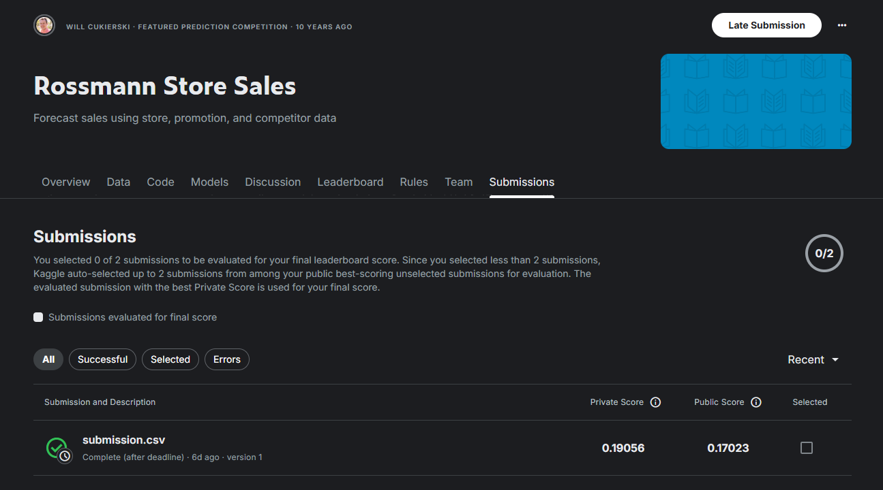
Kaggle Submission Performance

